Slide 1

VISUAL QUESTION ANSWERING

Slide 2
Under the Guidance Of:
Dr. Shilpa Choudari
Associate Professor
Computer Science Department
Ramaiah Institute Of Technology
Prepared By – Anurag Srivastava aaa
Brinda V Eshwar aaa
Chaitra H aaa
Abhijeet Shankar aaa

Slide 3
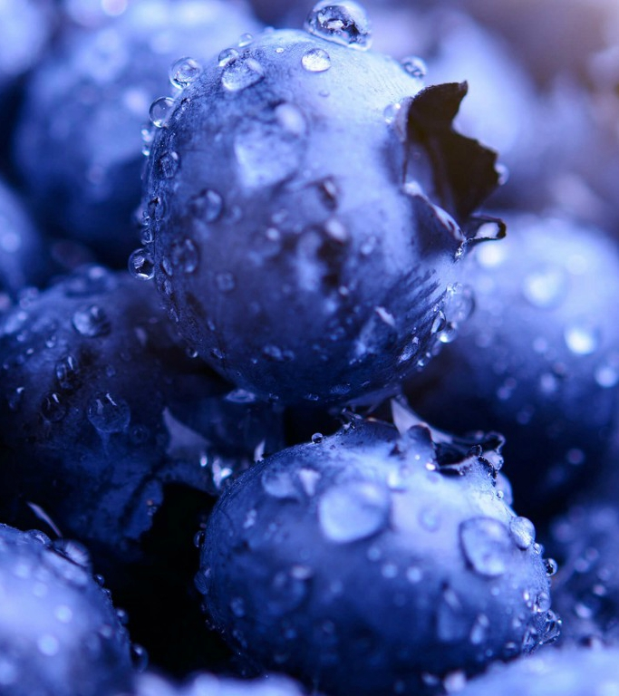
1
Understanding VQA
INTRODUCTION
VQA and it’s Importance
Present Scenario & Problems
Our Proposition

Slide 4
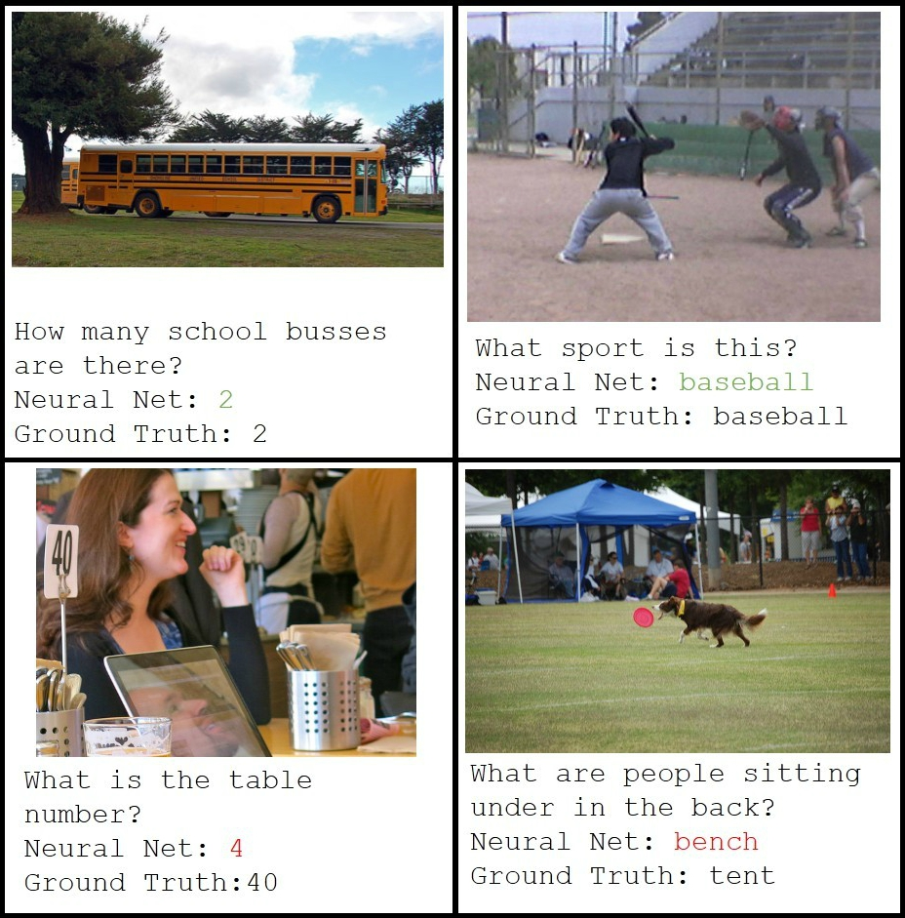
AaVISUAL QUESTION ANSWERING (VQA) aaa
VQA involves an image and a related question.
This process includes the fields of natural language processing and computer vision.
VQA is an example of the evaluation of deep visual understanding itself.

Slide 5
Aaa IMPORTANCE
In order to completely solve artificial intelligence, multi-model understanding of vision and natural language is paramount.
VQA is a pragmatic experiment to assess deep learning and visual understanding.
Deep visual understanding can also be interpreted as the potential of algorithms and techniques to obtain information of significance from images.

Slide 6
PROPOSITION
In our project we are including these three main features that will help us to attain superiority over any former work
“Using attention to increase efficiency”
We consider question based image attention.
“Region based focusing techniques”
We are focusing on which POS tag feature in the sentence is of interest.
“Changing loss function to enhance accuracy”
We first implement a baseline and then improving it.

Slide 7
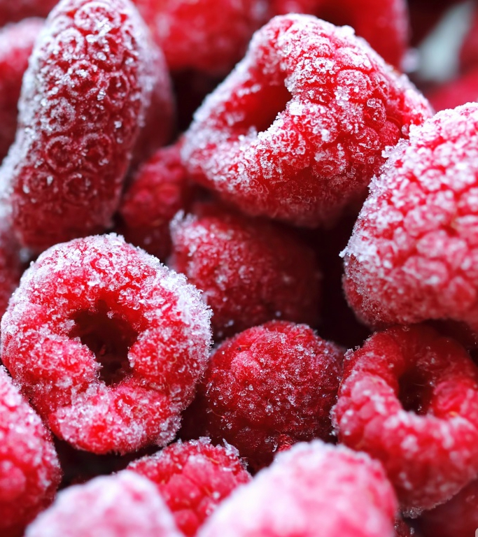
2
Cumulating Information
LITERATURE SURVEY
Former Work
Classification of Methods & Datasets
Survey Conclusion

Slide 8
Aaa CLASSIFICATION OF MODELS
Neural Networks
LSTM
Bayesian Models
MLP
Baseline Models
Skip-Thought Vectors
Variation + Semantic Segmentation
Attention Based Models
Region-Specific CNN
Hierarchical Co-Attention
Bilinear pooling
Multimodal Compact Bilinear
Compositional Model
NMN
RAU
Models
Quadratic Discriminant Analysis
Combination of Both
Variations

Slide 9
The models are classified
into the following five basic categories
Baseline Models
Bayesian Models
Attention Based
Bilinear Pooling
Compositional Models
Heuristics, simple summary statistics, randomness.
Its efficiency is very less.
Learning to ‘attend’ to the most relevant regions.
The problem of high dimensionality is resolved.
Modeling technique which generalizes QPT.

Slide 10
COMPARING BAYESIAN & MCB MODELS
Paper Number | Method | Dataset used | Image Network | Accuracy
3 | MCB | VQA real-image dataset +Visual Genome+Visual7W | ResNet- 152 | MCB(d=16k)with attention:62.50 Multiple choice QA-62.2 Based on dimension(16000):59.83
23 | Multi-modal Factorized Bilinear Pooling (MFB) with Co-Attention Learning | VQA | 152 layer ResNet | MFB+CoAtt+GloVe+VG : 71.3
36 | iBOWIMG | COCO VQA dataset | VGGNet, GoogleNet | 61.68
43 | Multi-modal compact bilinear pooling (MCB) | Task Driven Image Understanding Challenge (TDIUC) COCO-VQA | ResNet | 84.26
Serial No. | Paper | Data Set | Image Network | Accuracy
1 | Age and Gender Recognition in the wild with deep attention. | Morph – II + Adience | VGGNet - 16 | 73.2
14 | Visual Madlibs: Fill in the blank Description Generation and Question Answering. | MS COCO | VGGNet | 57.6
27 | Image Understanding using vision and reasoning through Scene Description Graph. | ILSVRC + Flickr 8K image + MS-COCO | QReasonable | 48.9
51 | Simple Baseline for Visual Question Answering. | COCO VQA dataset | VGGNet, GoogLeNet | 61
Table 1 - MCB Models
Table 2 - Bayesian Models

Slide 11
COMPARING BASELINE & ATTENTION MODELS
Serial No. | Paper | Data Set | Image Network | Accuracy
7 | LSTM An Empirical Evaluation of Visual Question Answering for Novel Objects | VQA | ImageNet | 56.4
12 | VQA: Visual Question Answering | VQA | VGGNet | 54.6
34 | Yin and Yang: Balancing and Answering Binary Visual Questions | MS COCO +VQA | ImageNet | 74
48 | Knowledge Acquisition for Visual Question Answering via Iterative Querying | Visual7W and VQA |  | Visual7W:0.52 and VQA :0.47
53 | Biometrics and forensics integration using deep multi-modal semantic alignment and joint embedding | Subset of Visual Genome | VGGNet - 16 | 57.3
Serial No. | Paper | Data Set | Image Network | Accuracy
5 | Adaptive Attention Fusion Network For Visual Question Answering | COCO-QA | 19-layer VGGnet | 64.7
19 | TGIF-QA: Toward Spatio-Temporal Reasoning in Visual Question Answering | TGFI-QA | ResNet, C3D, GloVe | 56,2
25 | Making the V in VQA Matter: Elevating the Role of Image Understanding in Visual Question Answering | VQA | VGGNet | 51.88
47 | ABC-CNN: An Attention Based Convolutional Neural Network for Visual Question Answering | Toronto COCO-QA, DAQUAR, and VQA dataset | ConceptNet | COCO-QA: 0.47DAQUA: .42 VQA:0.48
Table 3 - Baseline Models
Table 4 - Attention Models

Slide 12
CLASSIFICATION OF DATASETS
Image Processing
DAQUAR
COCO-QA
Convolution Neural Networks
The VQA dataset
COCO-VQA
SYNTH-VQA
FM-IQA
Visual Genome
Visual7w
SHAPES

Slide 13
COMPARING THE DATASETS
 | DAQUAR | COCO-QA | COCO-VQA | FM-IQA | Visual7W | Visual Genome
Total Images | 1449 | 123,287 | 265,011 | 120,360 | 47,300 | 108,0 0 0
QA Pairs | 12,468 | 117,684 | 614,163 | 250,569 | 327,939 | 1,773,258
Distinct Answers | 968 | 430 | 105,969 | N/A | 65,161 | 207,675
% covered by top-1000 | 100 | 100 | 82.8 | N/A | 56.29 | 60.8
% covered by top-10 | 25.04 | 19.71 | 51.13 | N/A | 17.13 | 13.07
Human Accuracy | 50.2 | N/A | 83.3 | N/A | 96.6 | N/A
Longest Question | 25 words | 24 words | 32 words | N/A | 24 words | 26 words
Longest Answer | 7 (list of 1 words) | 1 word | 17 words | N/A | 20 words | 24 words
Avg. Answer Length | 1.2 words | 1.0 words | 1.1 words | N/A | 2.0 words | 1.8 words
Image Source | NYUDv2 | COCO | COCO | COCO | COCO | COCO, YFCC
Annotation Evaluation Type | Manual + Auto OE | Auto OE | Manual MC or OE | Manual OE | Manual MC or OE | Manual OE
Question Types | 3 | 4 | - | - | - | -
All of the previous works have used CNNs for Image Processing.
The various datasets have been classified in the chart above.
Feature extraction methods - GoogLeNet & VGGNet, ResNet & ZeilerNet.

Slide 14
VQA DATASET
265,016 images (COCO and abstract scenes)
At least 3 questions (5.4 questions on average) per image
10 ground truth answers per question
3 plausible (but likely incorrect) answers per question
Automatic evaluation metric
Human Accuracy - 83.3

Slide 15
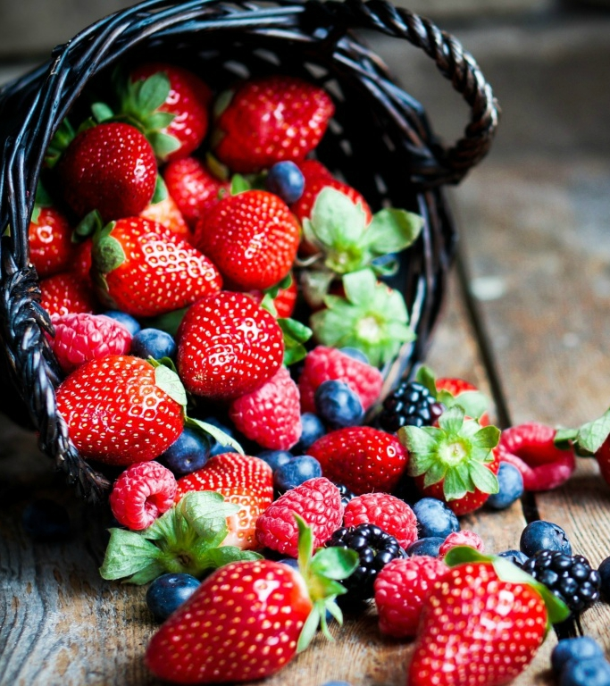
3
Shaping the Future
PROJECT PLAN
Functional Requirements
Use Case Diagram & Gantt Chart
Non-Functional Requirements

Slide 16
OVERVIEW & PLAN
It is categorized into the following five basic categories
Project Deliverables
Schedule Allocation
Resource Acquisition
Internal Structure
Assumptions & Constraints
Assume baselines models.
Schedule constraints have to be met.
Satisfactory efficiency.
Software model.
Linear dependency.
Project Plan -> Literature Survey -> Design -> Development -> Testing.
Data is open source.
Same amount of authority.
Communication and diplomacy required.

Slide 17
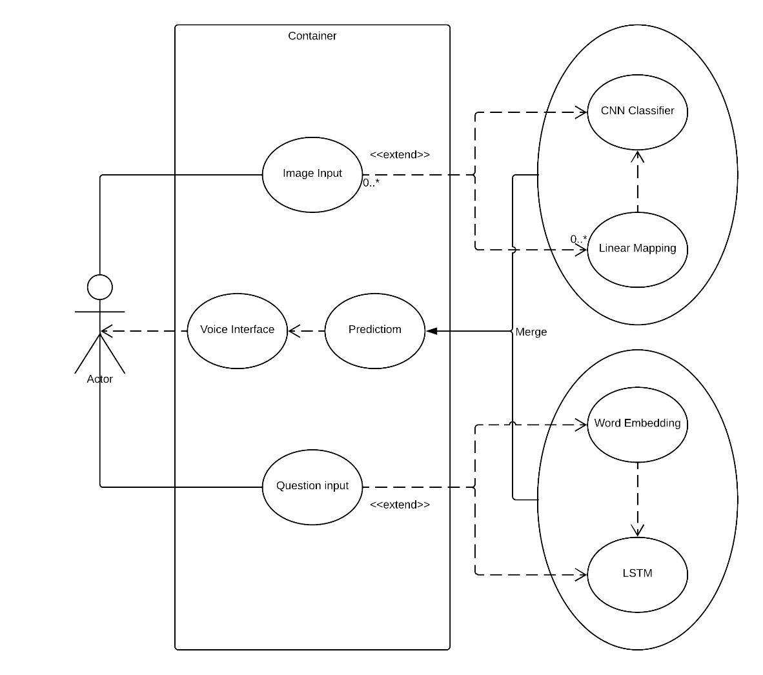
USE CASE DIAGRAM
GANTT CHART

Slide 18
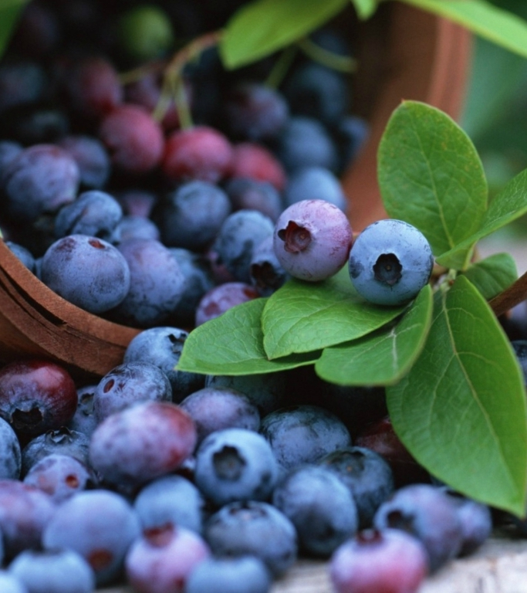
4
Sketching the Model
PROJECT DESIGN
Modelling VQA
Attention Based Models
UML Diagrams & Performance Metrics

Slide 19
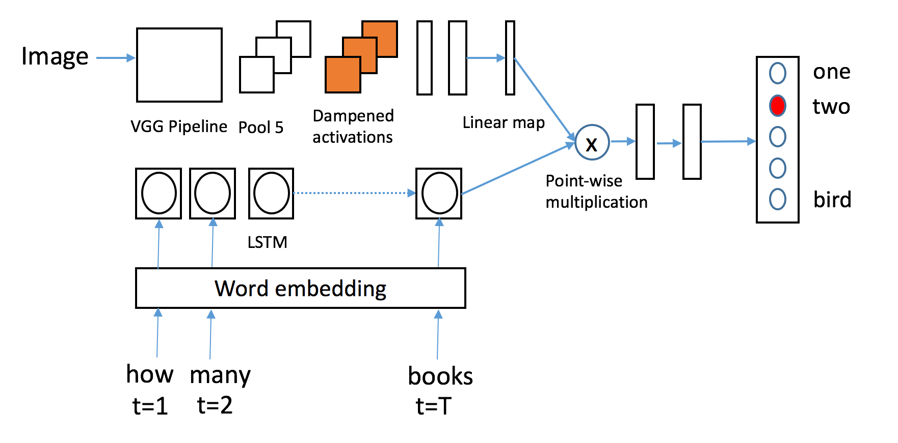
MODELLING VQA
Our model uses a LSTM unit to convert the question into a 1024 dimension encoding.
The question and image encodings are then fused.
The fused features are then passed through a multi-layer perceptron neural network classifier with 2 hidden layers and 1000 hidden units.

Slide 20
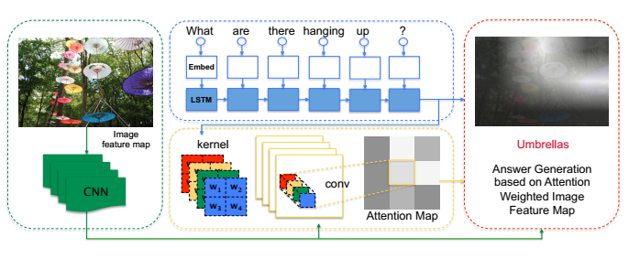
ATTENTION BASED MODEL
The green box denotes the image feature extraction; the blue box is the question understanding; the yellow box illustrates the attention extraction part; the red box is the answer generation part. The orange letters are corresponding variables.

Slide 21
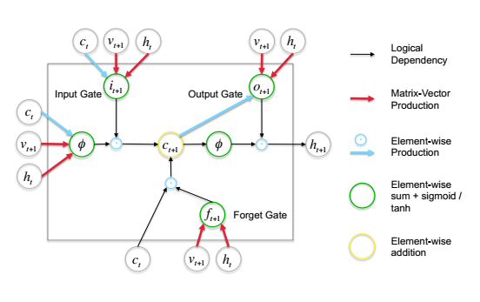
The Model is Composed of Four Components:
The Image Feature Extraction Part
The Question Understanding Part
The Attention Extraction Part
The Answer Generation Part
The structure of LSTM
for query processing

Slide 22
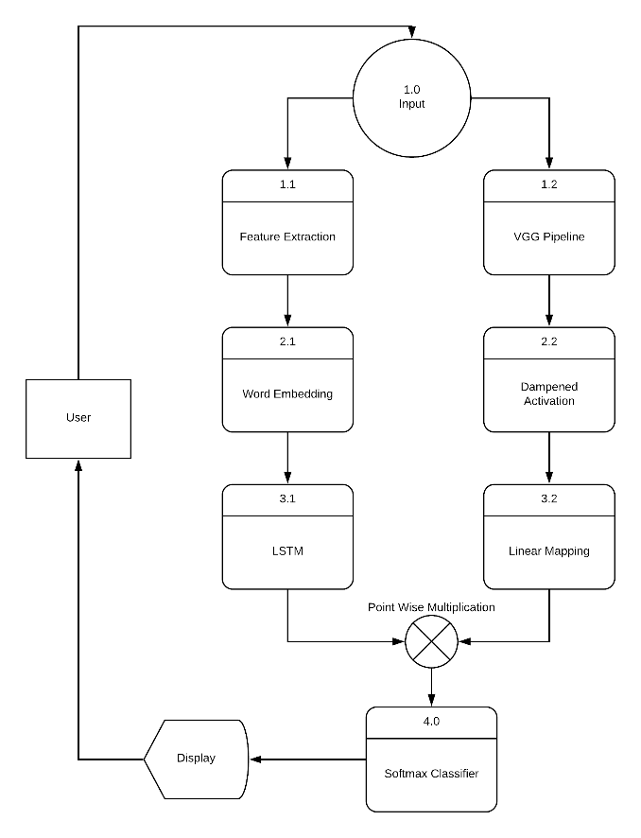
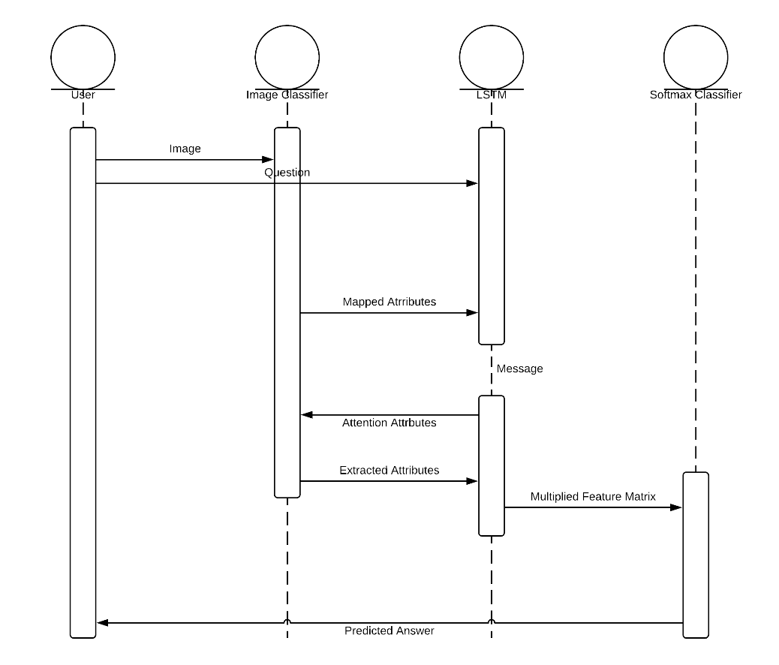
Data Flow Diagram
Sequence Diagram

Slide 23
PERFORMANCE METRICS
1
2
“answer accuracy” (ACC)
“Wu-Palmer similarity measure Set” (WUPS) score

Slide 24
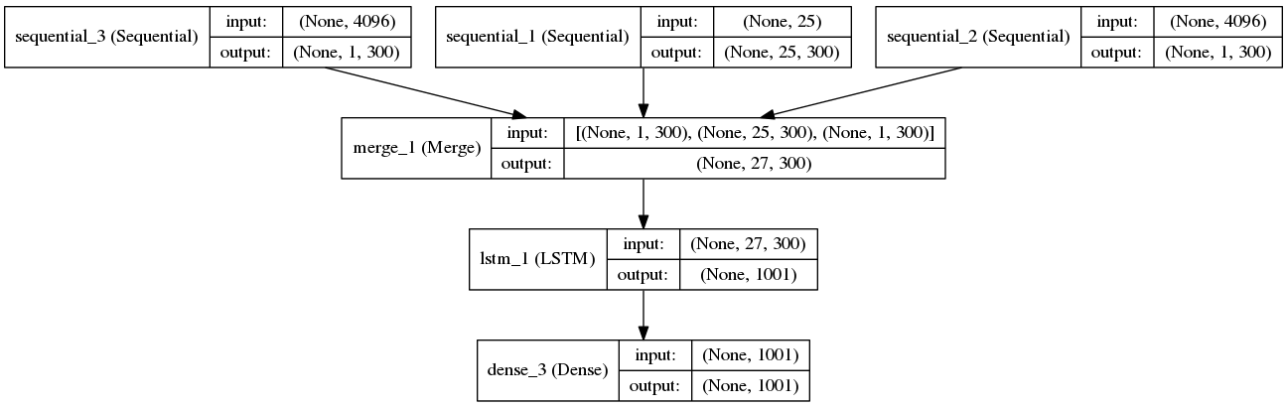
LSTM Model

Slide 25
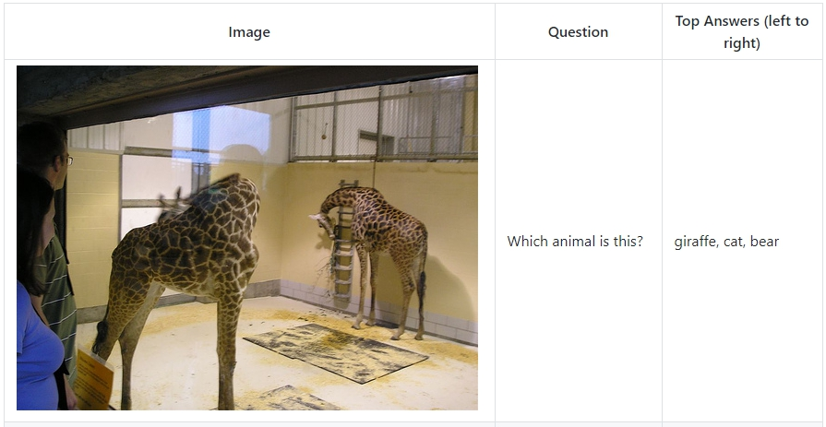

Slide 26
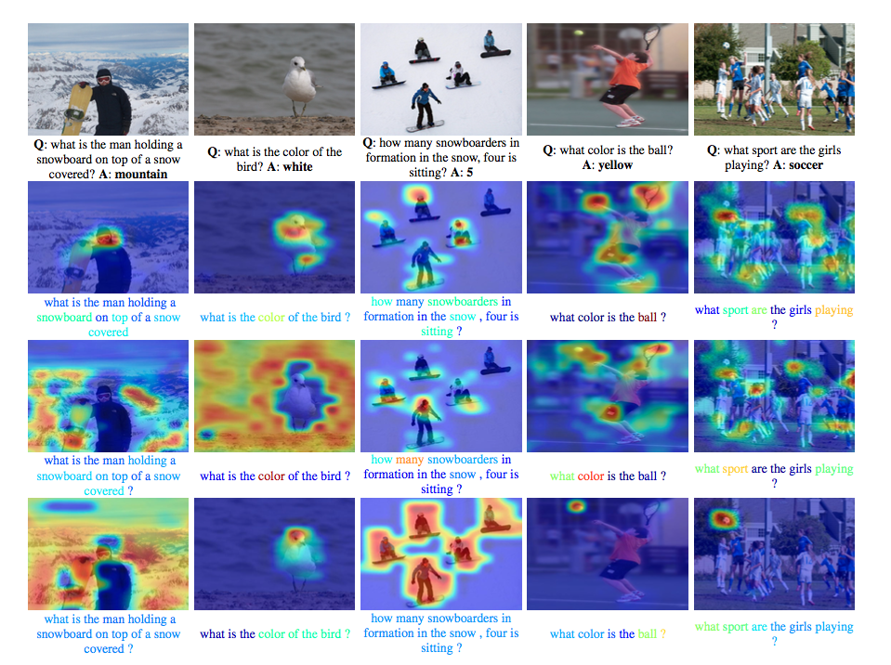

Slide 27
CONCLUSION

